Slide 1
Mobile shop management system
Developer:
Muhammad Talha (2021-CS-22)
Owner:
Mustafa (2021-CS-39)
Presented To:
Dr. Laeeq khan

Slide 2
Table of content
Technology Stack
Front End
Backend
Coding best practice

Slide 3
Table of content
Project Features
Project Management Tool
Communication with Owner
Github Report

Slide 4
Technology Stack
MongoDB
Express API
Flutter
Dart

Slide 5
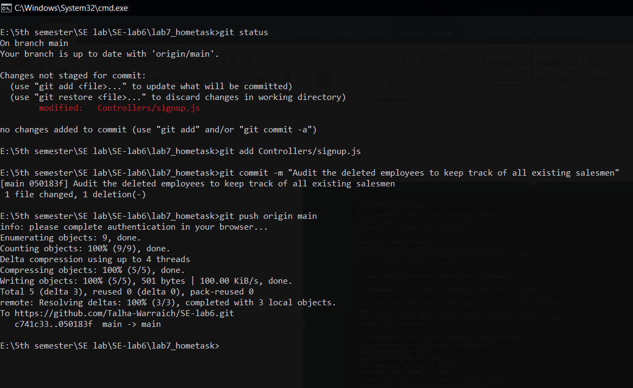
GitHub Commits

Slide 6
Front End
Technology Used :
Flutter
Dart

Slide 7
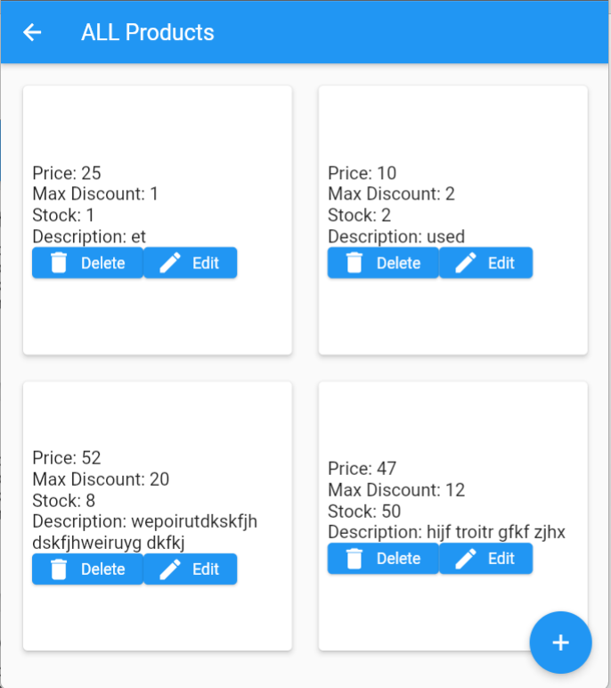
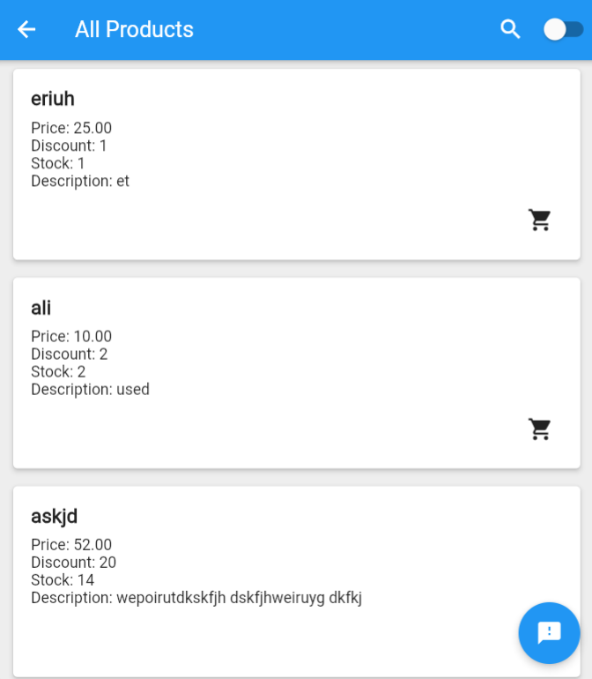
Front End

Slide 8
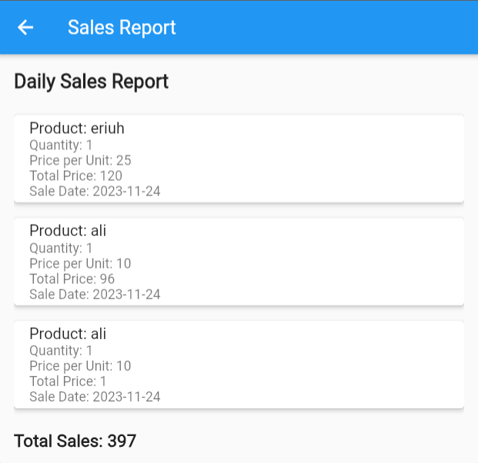
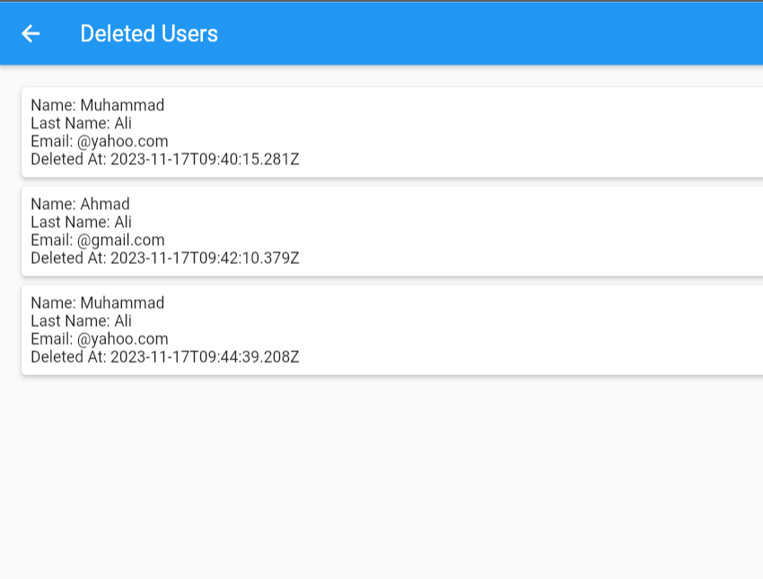
Front End

Slide 9
Backend
Backend Framework: Express.js
Programming Language: JavaScript
Database: MongoDB

Slide 10
Backend
Middleware for Authentication
API Endpoints (Routes)
Dependency Management: npm (Node Package Manager)
MVC(Model View Controller)

Slide 11
Project Features
Signup
Login
Authentication
Authorization

Slide 12
Project Features
Admin:
Admin Dashboard
Add Product
View Product
Update Product

Slide 13
Project Features
Admin:
Delete Product
Generate Reports
View Profile
Add new salesman
Remove salesman

Slide 14
Project Features
Salesman:
View all products
Sale product
Offer discount
Recommendations
Sales report

Slide 15
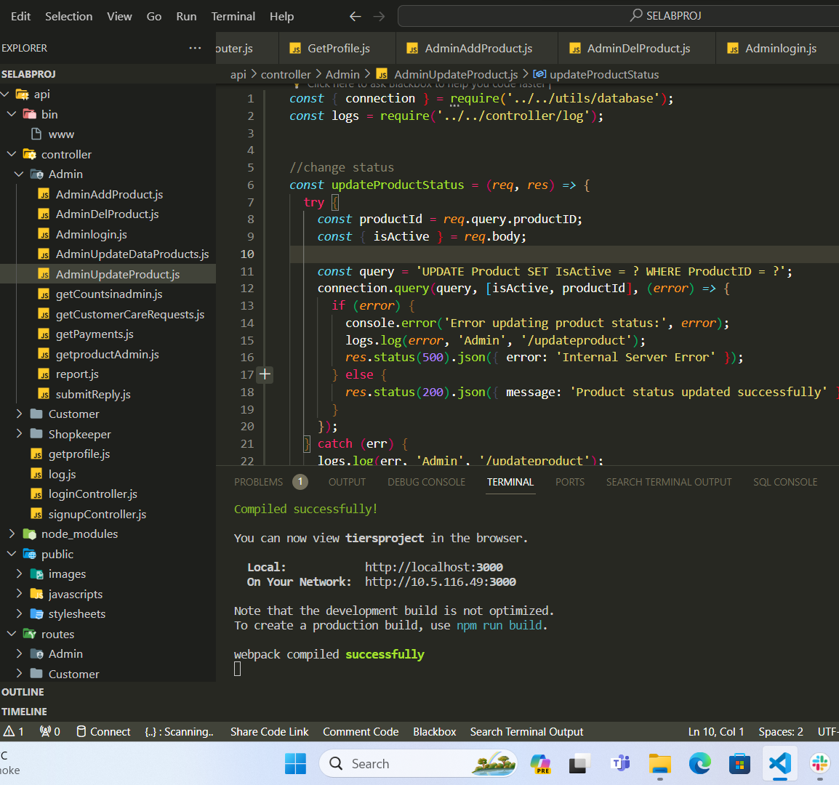
Coding Best Practice
File structured is managed
Naming Conventions
Comments added

Slide 16
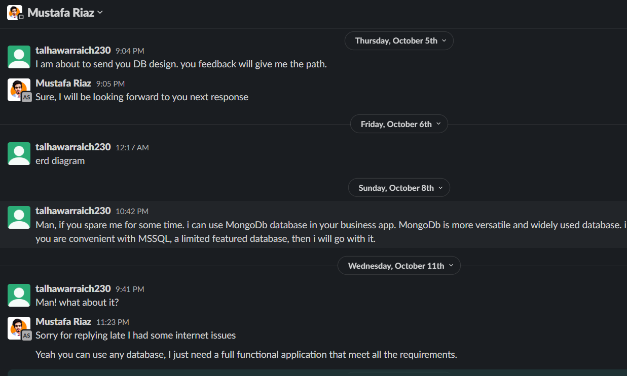
Owner Collaboration
Slack snapshot

Slide 17

THANK YOU
Muhammad Talha
talhawarraich230@gmail.com

